Slide 1
General Data Protection Regulation (GDPR)

Slide 2
What is GDPR?
GDPR is a European law which went into
effect on May 25, 2018
Governs the type of notice that must be provided to people regarding how their identifiable data is used
Governs how companies are allowed to use and process identifiable data
Has stricter requirements for using sensitive data

Slide 3
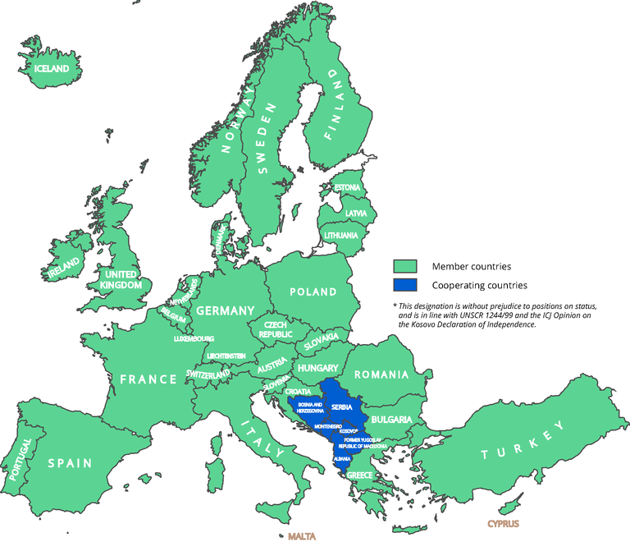
To Whom Does GDPR Apply?
Those who offer goods or services to persons in the EU/EEA
European Economic Area (EEA) = European Union (EU) + Iceland, Liechtenstein, Norway, & UK
Those who control and process data about persons in the EU/EEA
Personal Data = any information that can identify a person
Sensitive Data = race/ethnicity, political opinions, religious/philosophical beliefs, union membership, genetic data, biometric data, health data, data concerning a person’s sex life or sexual orientation.

Slide 4
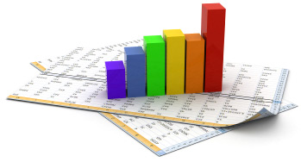
Who Are Controllers and Processors?
Controllers specify the means and purpose of the data processing
Example: Industry Sponsor, PI of Investigator-Initiated research
Processors conduct the processing under the direction of the controller
Clinical Research Coordinators, Database Administrators, PI of Industry-Sponsored research

Slide 5
What is Data Processing?
Processing of data involves any and all of the following:
Adapting
Altering
Collecting
Combining
Consulting
Destroying
Disclosing
Erasing
Organizing
Recording
Retrieving
Storing
Structuring
Using

Slide 6
What is Needed to Process Data?
A “lawful basis” for doing so
A “lawful basis” can be:
When required for a contract
When required for public interest
When required to comply with a law
When required to protect an individual’s life
When required for the legitimate interests of a third party (no sensitive data)
When freely given consent for a specific purpose has been provided
If sensitive data is being processed, explicit consent for those data elements is required.

Slide 7
What Elements of Consent are Needed?
Name and/or title of the data processor
The purpose and basis for processing of the subject’s data
The type of data to be processed
Remember: When sensitive data are going to be processed, these data elements must be explicitly listed in the consent.
If data will be transferred to a less secure country (i.e. the U.S.)

Slide 8
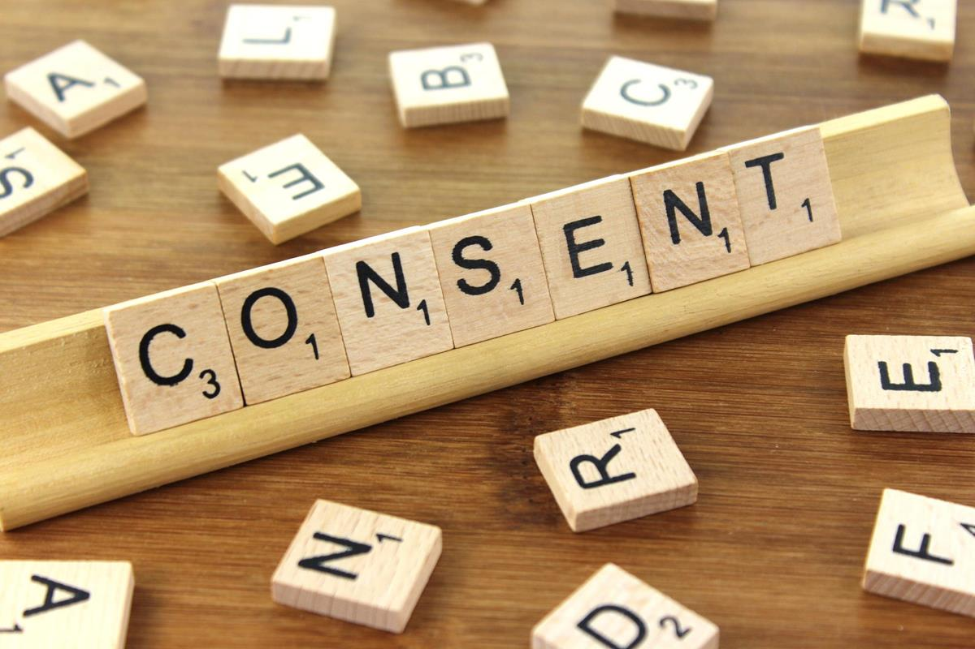
What is Needed for Legally Effective Consent?
Must be in clear and plain language, intelligible, and easily accessible
Must be specific about the purpose of the data processing
Must be distinguishable from other matters
Must be given by a clear act or statement
Must be an unambiguous indication
Must fully inform the data subject
Must be freely given

Slide 9
I Got Consent! Now What?
Processors and Controllers must ensure privacy:
Limit access to the data
Code or encrypt the data where possible
Limit processing to only the necessary data
Retain the data for the least amount of time possible
Incorporate data protection into the processing activities

Slide 10
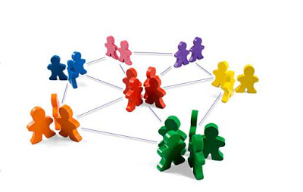
What About Secondary Research?
Secondary research also requires a “lawful basis” for processing of personal data
Sensitive data must be explicitly detailed in the consent document
The purpose of the secondary research must be compatible with the initial purpose when consent is not obtained initially

Slide 11
What Are the Subject’s Rights Under GDPR?
Rectification of the personal data
Notice when their personal data is used
Includes modifications and erasures
Can restrict how their data are processed
Can reject automated individual decision-making
Access to their personal data collected about them
Must be able to receive their data and transfer it to a third party

Slide 12
I’m a U.S. Researcher, Does This Rule Apply?
Most research in the U.S. is not subject to this rule
Exceptions (including but not limited to):
Web-based surveys
Studies with long-term follow-up
Long-term biometric monitoring studies
Studies sponsored by companies in the EU/EEA

Slide 13
How Can I Remain Compliant?
Exclude people in the EEA from taking web-based surveys
Ask participants if they’ll be travelling to the EEA during the study
No GDPR language in consent when people in the EEA aren’t subjects
Include GDPR template language when appropriate
The IRB provides template language on our template
“HRP-502 Template – General (2018 Common Rule
Compliant” on our forms page

Slide 14
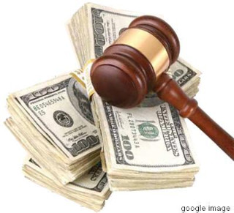
What Happens if I Don’t Follow GDPR?
Fine of either €20,000,000 or 4% of annual revenue (whichever is more) for:
Not having a “lawful basis” to process data or getting insufficient consent
Not being able to allow individuals to exercise their rights
Fine of 2% of annual revenue for:
Not having records in order
Not providing proper notification of a breach

Slide 15
QUESTIONS?

